Slide 1
Packed cell volume (PCV)
Hematocrit

Slide 2
Volume of RBC_{s} ∕ unit volume of whole blood i.e. percentage of packed cells to the whole blood.
Normal value: for ♂ 40% -54% (47%)
♀ 36%- 47% (42%)

Slide 3
Aim of the experiment
Screening test for anemia and polycythemia
PCV↑↑ in polycythemia & dehydration.
PCV↓↓ in anemia.
The color of plasma may give an indication about some illness, red (hemolysis), yellow (jaundice) and milky (hypercholesterolemia).

Slide 4
Instruments
Special tubes →→ wintrobe hematocrit tube or Capillary tube
Sample of blood + anti coagulant.
Centrifuge the tube for 30 mint at 3000 rev./min.
The blood separated into 3 layers:
Top layer (plasma) clear.
Middle thin layer Buffy coat less than 1mm in thickness (WBC_{s} & platelets).
Dark red color bottom layer (RBC_{s}).

Slide 5
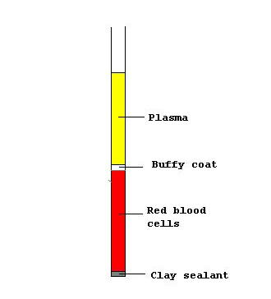

Slide 6
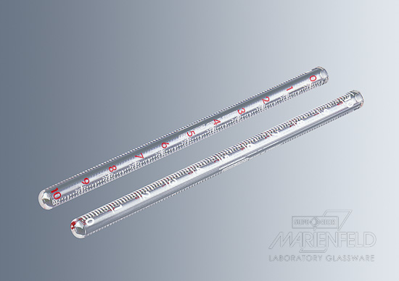

Slide 7
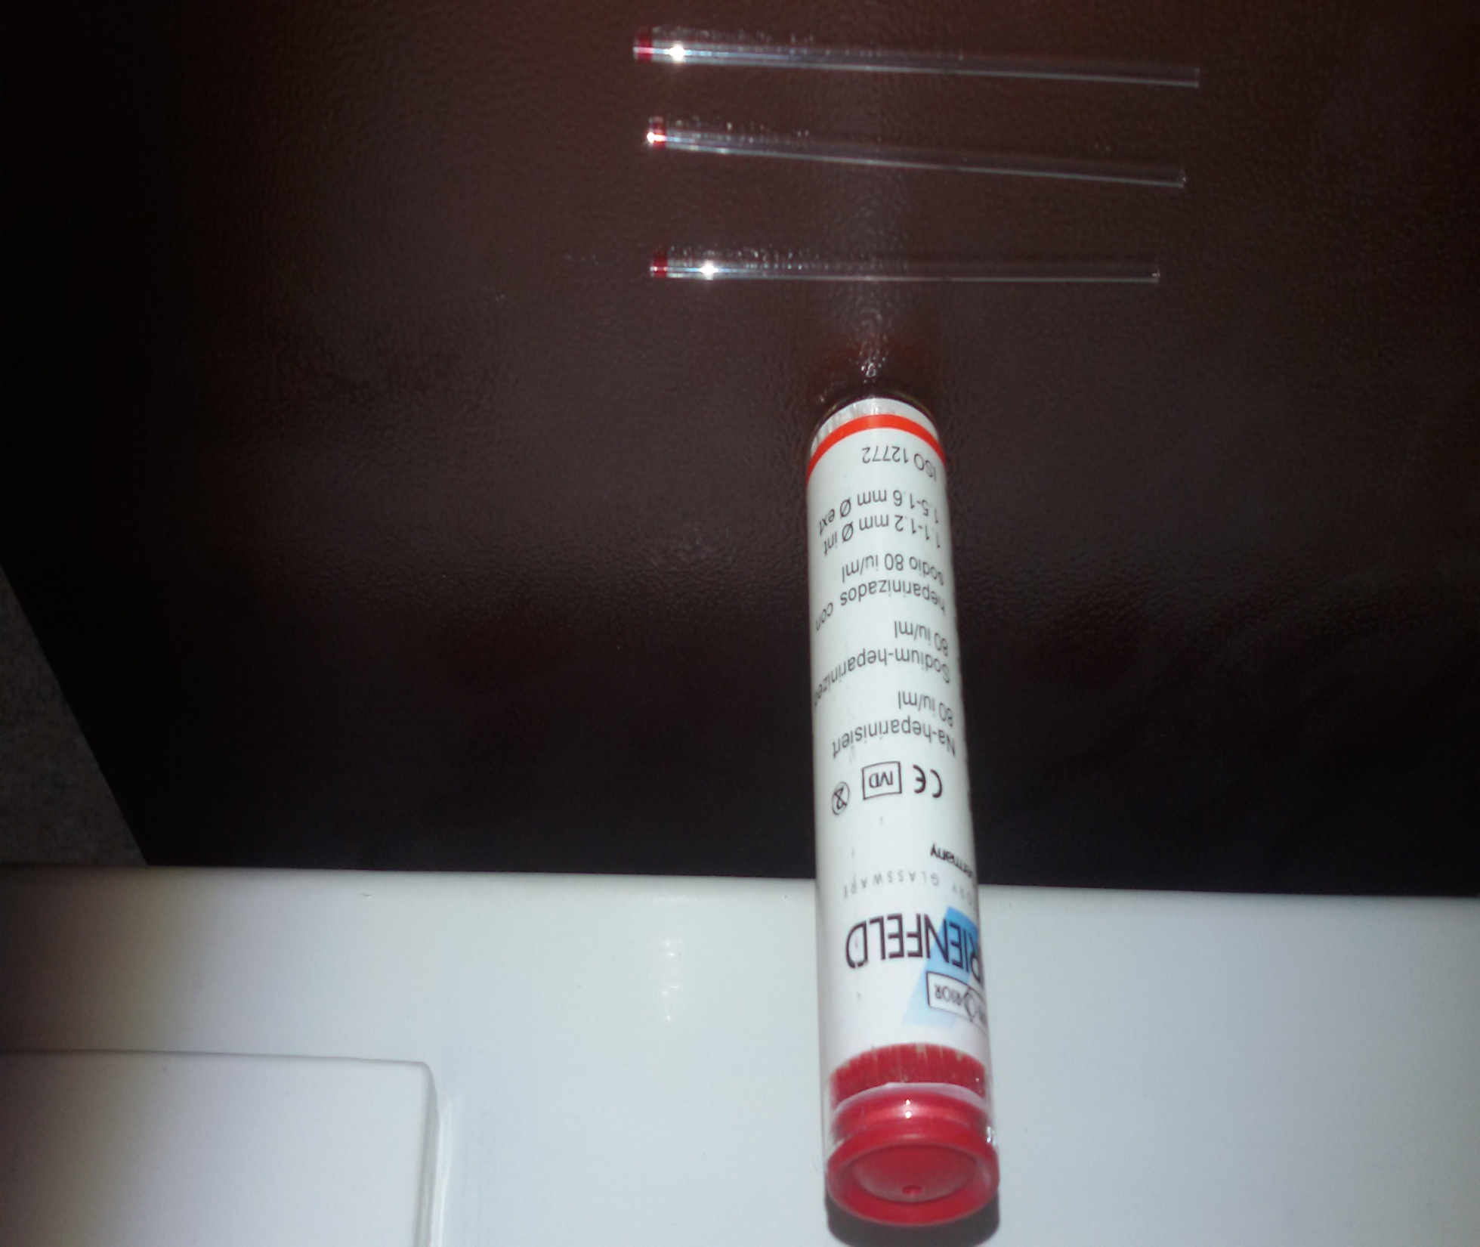

Slide 8
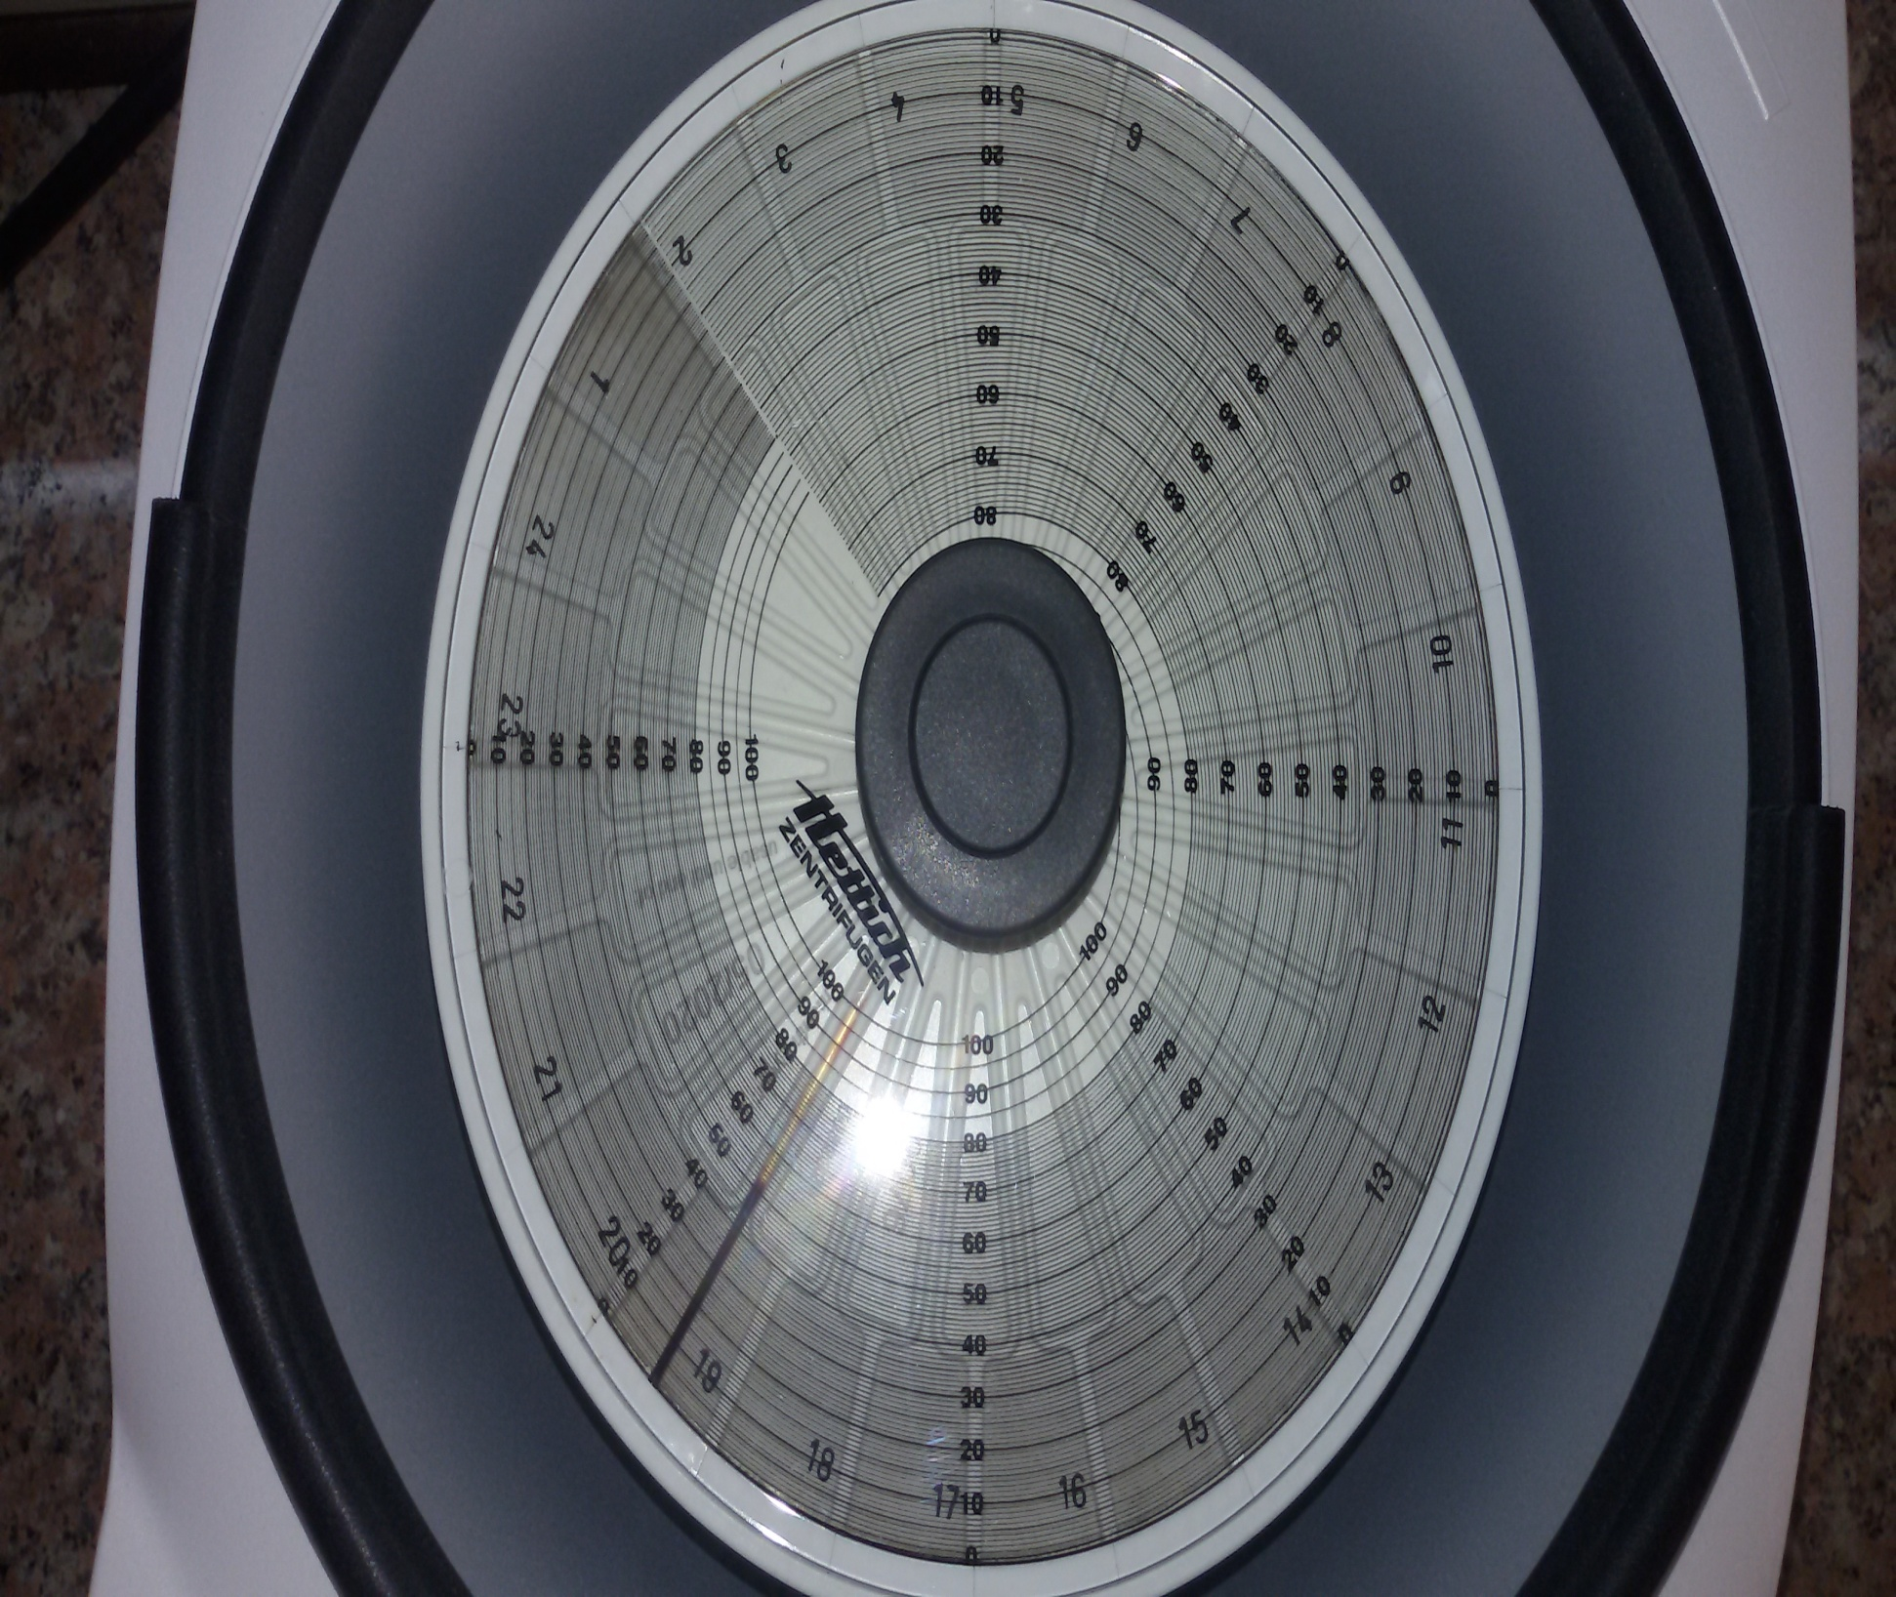

Slide 9
Factors affecting PCV
No. of RBC
Shape of RBC
Plasma volume

Slide 10
Erythrocyte sedimentation rate (ESR)
is the rate of red blood cell in whole blood descend in a standardized tube in a period of one hour.
a non-specific test.
Its used to monitor the inflammation.
Useful for monitor some chronic disorder like tuberculosis, autoimmune disease and others.

Slide 11
Mechanism
ESR is determined by the interaction between factors that promote sedimentation(fibrinogen) and resist (negative charge of RBCs - that repel each other) sedimentation.
Normal RBCs settle slowly as they do not form rouleaux or aggregate together. Instead, they gently repel each other due to the negative charge on their surfaces.

Slide 12
Rouleaux are stacks of many RBCs that become heavier and sediment faster.
Plasma proteins, especially fibrinogen, adhere to the red cell membranes and neutralize the surface negative charges, promoting cell adherence and rouleaux formation

Slide 13
Factors affecting ESR
No. of RBC_{s}
↑↑PCV will lead to reoulox phenomena that lead to↓↓ESR.
Shape of RBC
The size and number of RBCs that show alterations in their bioconcavity, like spherocyte and sickle cells.

Slide 14
Fibrinogen plasma protein.(↑↑fibrinogen lead to ↑↑reoulox phenomena that lead to ↑↑ESR).
Technical factors Temperature (18-25 C) higher temperature cause false high results due to reduction in plasma viscosity Vibration can reduce the ESR

Slide 15
Some conditions with low ESR
Polycythemia
Sickle cell anemia
Sever Leukocytosis

Slide 16
High ESR Some conditions with
Tuberculosis.
Malignancies .
Severe anemia .
Multiple myeloma

Slide 17
Normal Value Of ESR
Adult females 0-20 mm/h
Adult males 0-15 mm/hr
Children (<10) 0-10 mm/hr

Slide 18
Aim of the experiment
Responsible for prognosis (follow up) of the disease.

Slide 19
Procedure
1. Blood collect from vein puncture and mixed with anticoagulant (EDTA), heparin or sodium oxalate
2. place blood in narrow vertical tube (westergren tube)
3. Calculate the RBCs have falls in one hour

Slide 20
When blood mix with an anti coagulant & allow to stand vertically in a special tube (westergren tube) for a period of time (one hour).
The RBCs will settle down (sediment) leaving clear plasma layer above.
The rate at which RBC_{s} sediment is ESR and it is measured by the distance in which the RBCs are settle down in mm./period of time which is usually one hour.

Slide 21
Why RBC_{s} settle down (sediment)?
Aggregation of RBC_{s} one over the top of other, the surface area reduce & their weight will increase i.e. reoulox phenomena.

Slide 22
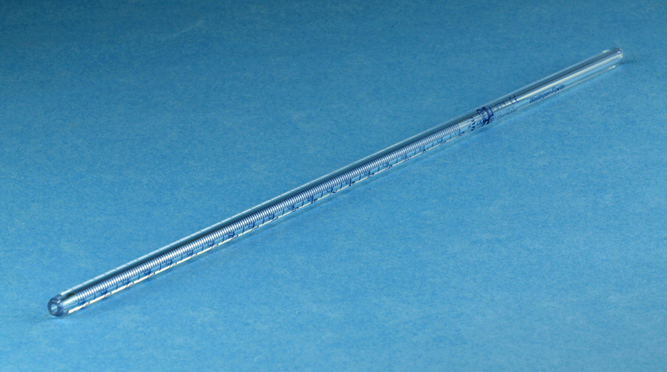

Slide 23
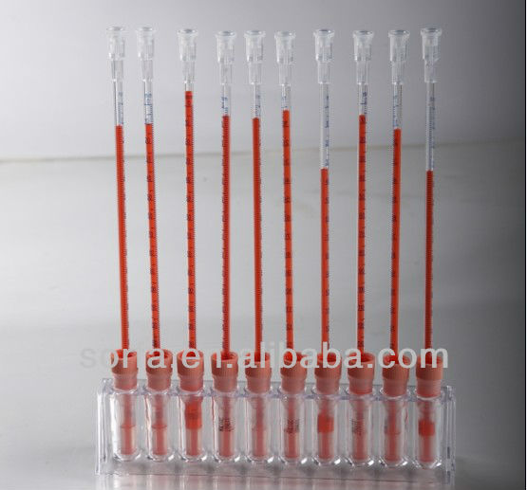

Slide 24
